Slide 1
Distributed Control and Automation Framework (DCAF)
DCAF Debugging
Benjamin Celis, Simon Perez Santa Maria

Slide 2
Agenda
RT debugging Challenges
Basics RT Debugging
Running modules outside of the Engine
Debugging Reentrant Vis.
Debugging tools
Syslog
Tag View
CVT
Shared Variables.

Slide 3
DCAF Temperature Chamber
CRIO Hardware
DCAF Scan Engine Module
DCAF Engine
DCAF UDP Module
UDP
DCAF UDP Module
DCAF Engine
DCAF UI Module
UI VI

Slide 4
RT Debugging Challenges
Complex Systems
Multiple devices
Cant Debug Re-entrant VI in RT
RT system might be running headless
Network Issues
Process Starvation
Timing Issues
Race Conditions

Slide 5
Basics RT Debugging

Slide 6
Follow Programing Best Practices
The best way to not have a bug is to prevent it in the first place.
Best practices reduce the possibility of bugs to happen and makes it easier to find them once they happen.
Best Practices Include:
Modular code
Unit Testing
Single Writers
Reduce number of global resources.

Slide 7
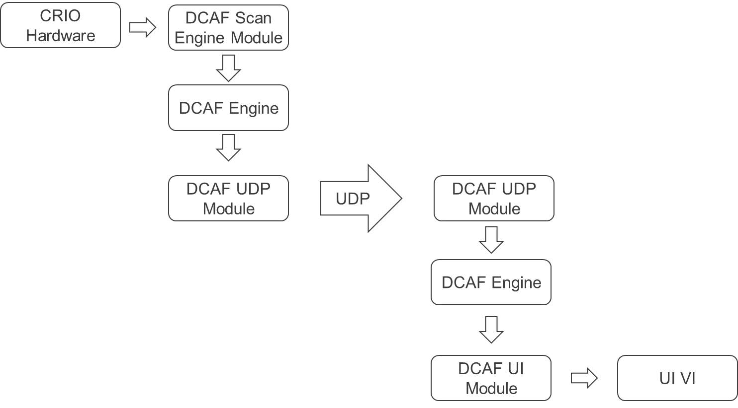
Where is the Bug?
Modular Code and Unit Testing
If we don’t know if individual components work
we don’t know if the whole system works
Error Handling
Hard to find ignored errors and errors that are
overwritten
Use External Tools like Max
and Distributed System Manager
Notes:
Blaming the engine.

Slide 8
Error Wiring
Error Propagation
Unwired errors
Unreported errors

Slide 9
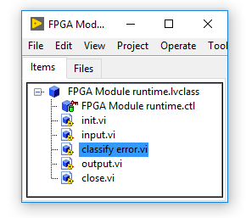
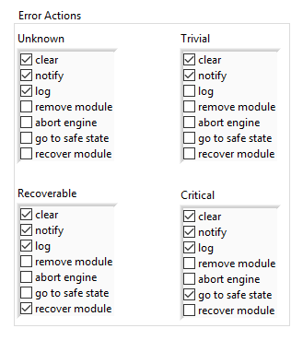
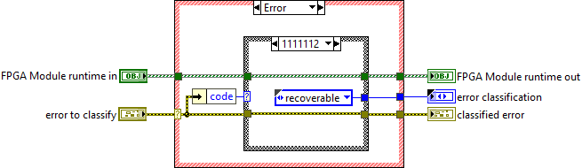
DCAF Error Management

Slide 10
Debugging Reentrant VIs

Slide 11
Reentrant clones.
Use breakcpoints
Use nonreentrant Vis (useful if you only have 1 instance)
Use syslog (but include clone information)

Slide 12
Running Modules Outside of the Engine

Slide 13
Make sure parts work before testing the whole
Test the module with Unit Test of test outside of the engine
Sometimes you need to test in the engine, publish the tags.

Slide 15
Syslog

Slide 16

Syslog
Available in Linux RT Targets
Event sent to Log:
Initialization and shutdown of all software modules
Any error reported to the engine
Any module trace messages added via the API

Slide 17
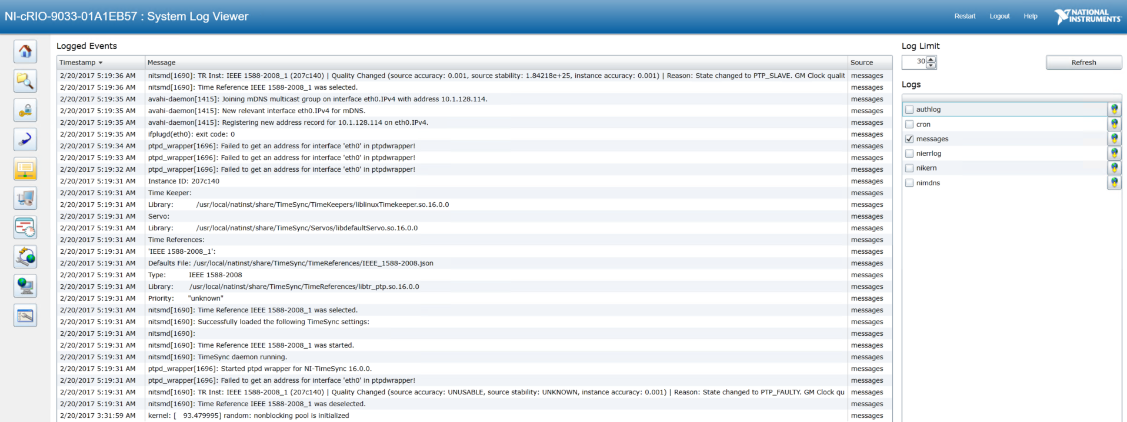
Syslog - System Log View

Slide 18
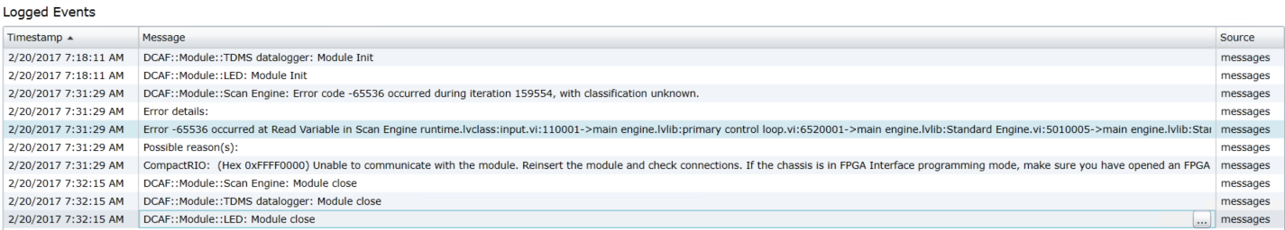
Syslog - System Log View

Slide 19
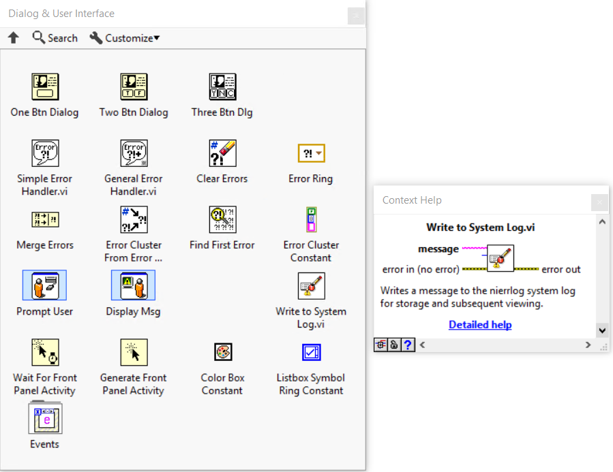
Syslog
NI Linux RT targets already have a syslog-ng daemon running
DCAF taps into the existing background process to log and report messages
You can, too!
Notes:
Add WIF

Slide 20
CVT

Slide 21
What is CVT
Use DCAF CVT Module
ADD CVT tags to the main VI
Make sure the name is correct (handle errors for the tags)

Slide 22
Shared Variables
Shared Variables have the limits but sometimes they can help debug RT applications
Use with care with Clones

